Slide 1

NIOS II Development with the Altera DE2-115 FPGA and the CPUlator Simulator
Presented by: Alae Bouchiba
Elyes Khechine
GitHub

Slide 2
01
FPGA
Filed-Programmable Gate Array

Slide 3
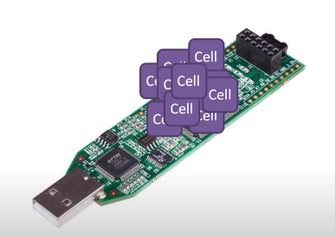
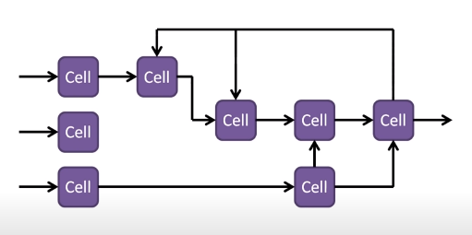
What is an FPGA?
FPGA stands for field programmable gate array. It's an integrated circuit or chip that allows you to design completely custom digital logic– hence the term field-programmable.
The FPGA configuration is generally specified using a hardware description language (HDL).
FPGAs are made up of a bunch of logic cells that act as fundamental building blocks for creating digital circuits.
You can configure the individual cells to operate in certain ways and you can connect the cells together to form the basis of any number of digital circuits.

Slide 4
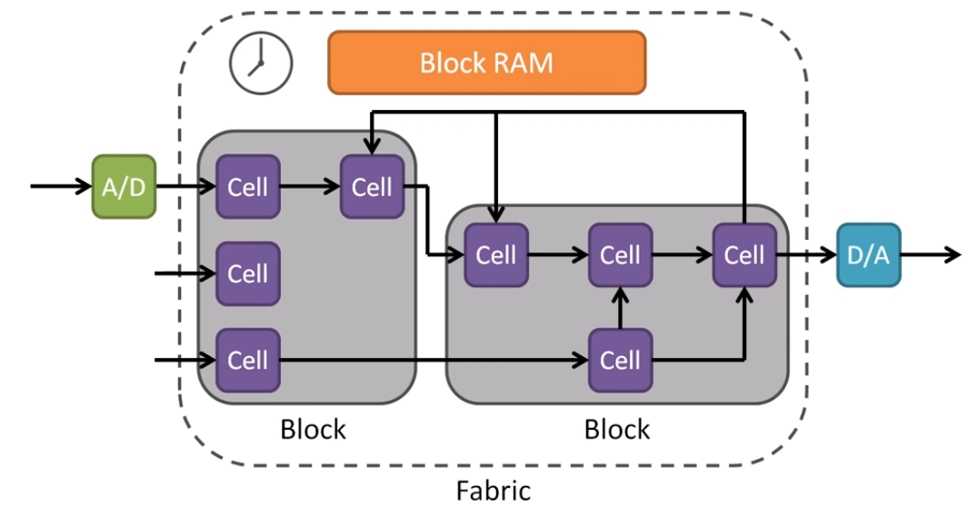
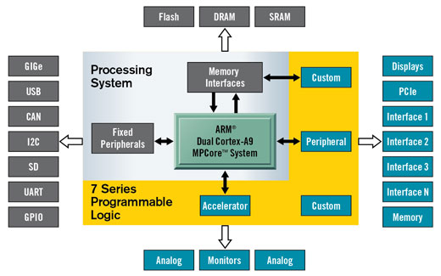
What is the advantage of an FPGA?
Some FPGAs can have other peripherals like analog to digital converters or analog outputs cells which are often grouped into programmable logic blocks and this reconfigurable group of interconnected hardware is often referred to as the FPGA fabric.
Logic blocks can be configured to perform complex combinational functions, or act as simple logic gates like AND and XOR.
Many FPGAs can be reprogrammed to implement different logic functions, allowing flexible reconfigurable computing as performed in computer software.
FPGAs have a remarkable role in embedded system development due to their capability to start system software development simultaneously with hardware, enable system performance simulations at a very early phase of the development before final freezing of the system architecture.

Slide 5
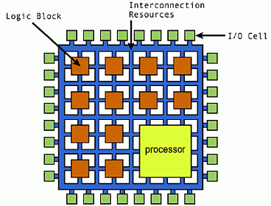
What is a Softcore Processor?
Unlike a purpose-built microcontroller/processor which has static peripherals, in an FPGA you can use these logic blocks to make your own processor. This is known as a softcore processor, and it allows you to run code like you would on a microcontroller or microprocessor.
Soft CPUs are microprocessors whose architecture and behavior are fully described using a subset of a hardware description language (HDL). If you have the space, you might even be able to implement more than one processor on the FPGA.
In contrast, you may or may not have access to some of the peripherals you find on a microcontroller like those analog to digital converters.
Soft processors can be synthesized for any application-specific integrated circuit (ASIC) or field programmable gate array (FPGA) technology.

Slide 6
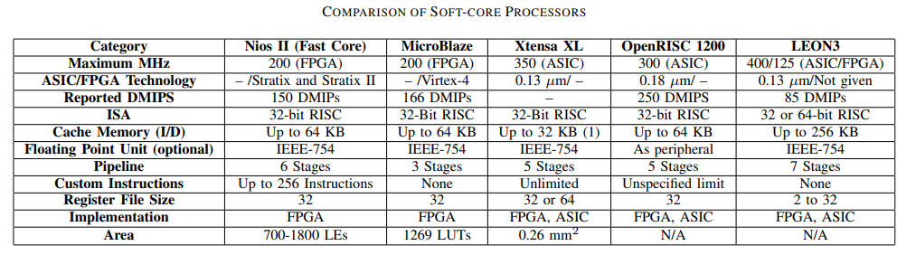
Examples of Soft CPUs
Nios II, MicroBlaze, PicoBlaze and Xtensa are the leading soft-core processors provided by Altera, Xilinx and Tensilica respectively.
As shown in the table, LEON3 has the highest operating frequency for ASIC implementation but has the lowest for FPGA implementation. The Nios II and Microblaze soft-core processors have the highest operating frequency for FPGA implementation.

Slide 7
02
Nios II Processor
The World's Most Versatile Embedded Processor

Slide 8
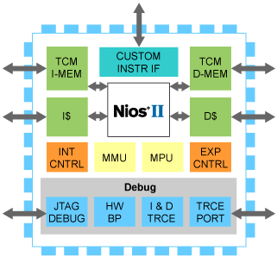
Nios II Processor
The Nios II Soft-Core Processor is a general purpose 32-bit Reduced Instruction Set Computer (RISC) embedded processor core that features a Harvard memory architecture.
It is a successor to Altera's first configurable 16-bit embedded processor Nios, introduced in 2000.
It features major improvements focused on the reduction of logic element (LE) consumption on an FPGA and improved performance, making it more suitable for a wider range of embedded computing applications, from digital signal processing (DSP) to system-control.

Slide 9
Nios II Processor Features
Single-Cycle Hardware
Multiply and barrel shifter.
Separate Instruction and Data Caches
Configurable from 512 bytes to 64 KB.
Custom Instructions
Achieve Maximum DMIPS
Up to 256 custom instructions and unlimited hardware accelerators.
Up to six-stage pipeline to achieve maximum DMIPS per MHz.
External Vector Interrupt Controller
Access up to 4 GB of external address space
Up to 32 interrupts per controller.
Advanced Exception Support
Optional Tightly-Coupled Memory for Instructions and Data

Slide 10
Benefits of Nios II Embedded Processors
Flexibility
Long Life Cycle
01
02
Low Cost
High Performance
03
04
With the perfect fit of CPUs, peripherals, memory interfaces, and custom hardware peripherals to meet the unique demands of every new design cycle.
Nios II processors can help product developers to maximize their return on a product by providing life cycle benefits at every stage of a product's life.
Provides phenomenal cost flexibility, allowing to choose the exact set of processors, peripherals, memory, and interfaces needed for an application, without paying for features that aren’t needed.
Giving the ultimate flexibility to achieve the exact performance required for an embedded design, without overpaying for high clock frequency, power-hungry off-the-shelf processors.

Slide 11
Benefits of Nios II Embedded Processors
JTAG Debug Module
Hardware Acceleration
05
06
Nios® II Processor Cores
07
The architecture supports a Joint Test Action Group (JTAG) debug module that provides on-chip emulation features to control the processor remotely from a host PC.
Similar to hardware accelerators, custom instructions allow Nios II processor designers to increase system performance by offloading portions of the software code to hardware functions.
Used by more designers than any other soft processor in the world, Nios II embedded processors remain the industry-standard processor for FPGA design.

Slide 12
Nios II Processor Family
The NIOS II family consists of three members – fast (II/f), economy (II/e) and standard (II/s) – each optimized for a specific price and performance range. All three cores use the same instruction set architecture (ISA) and are 100% binary code compatible.
Nios II/f (fast)
Nios II/e (economy)
Nios II/s (standard)
Optimized for highest performance, optional memory management unit (MMU), or memory protection unit (MPU)
Designed for smallest possible logic utilization of FPGAs. This is especially efficient for low-cost FPGA applications.
Designed to maintain a balance between performance, size and cost

Slide 13
Nios II Family Specifications
Nios II classic is offered in 3 different configurations: Nios II/f (fast), Nios II/s (standard), and Nios II/e (economy).
Nios II gen2 is offered in 2 different configurations: Nios II/f (fast), and Nios II/e (economy).
Nios II/f | Nios II/s | Nios II/e
Separate instruction and data caches (512 B to 64 KB) Optional tightly coupled memory for instructions and data Six-stage pipeline to achieve maximum DMIPS/MHz Single-cycle hardware multiply and barrel shifter Optional hardware divide option Dynamic branch prediction Up to 256 custom instructions and unlimited hardware accelerators Optional JTAG debug module enhancements, including hardware breakpoints, data triggers, and real-time trace | Instruction cache Optional tightly coupled memory for instructions Five-stage pipeline Static branch prediction Hardware multiply, divide, and shift options Up to 256 custom instructions Optional JTAG debug module enhancements, including hardware breakpoints, data triggers, and real-time trace | Complete systems in fewer than 700 LEs Optional debug enhancements Up to 256 custom instructions Free, no license required

Slide 14
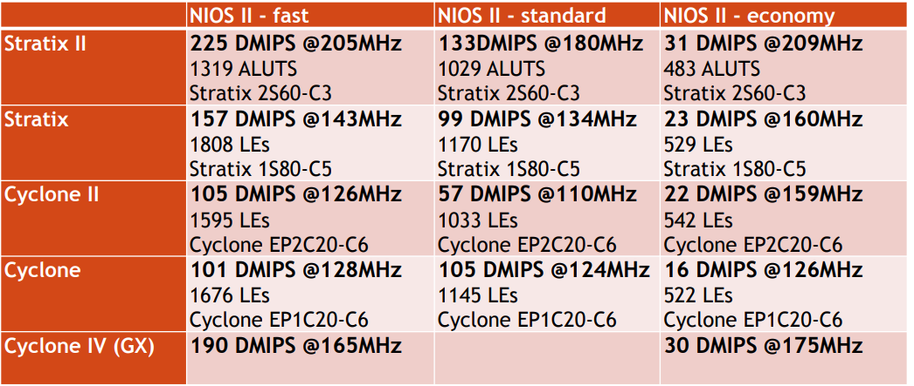
Nios II Processors Performance Comparison
The Nios II family of processors can be used in Altera’s Stratix and Cyclone series of FPGAs.

Slide 15
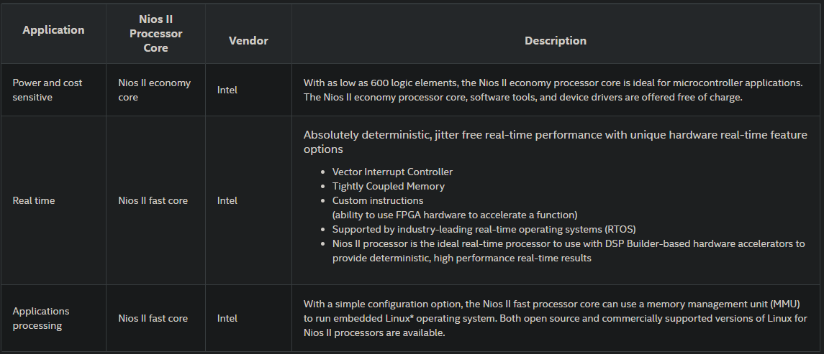
Nios II Industry Benefits and Applications

Slide 16
Nios II Development Processes
Development is hosted inside an Altera application called the Embedded Design Suite (EDS). The EDS contains a complete integrated development environment to manage both hardware and software in two separate steps:
01. Hardware Generation
02. Software Creation
Nios II hardware designers use the Qsys system integration tool, a component of the Quartus-II package, to configure and generate a Nios system.
The configuration graphical user interface (GUI) allows users to choose the Nios-II's feature-set, and to add peripheral and I/O-blocks (timers, memory-controllers, serial interface, etc.) to the embedded system.
Qsys is replacing the older SOPC (System-on-a-Programmable-Chip) Builder, which could also be used to build a Nios II system, and is being recommended for new projects.
EDS is based on the Eclipse IDE, the EDS includes a C/C++ compiler, debugger, and an instruction-set simulator.
EDS allows programmers to test their application in simulation, or download and run their compiled application on the actual FPGA host.
Because the C/C++ development-chain is based on GCC, the vast majority of open source software for Linux compiles and runs with minimal or no modification.

Slide 17
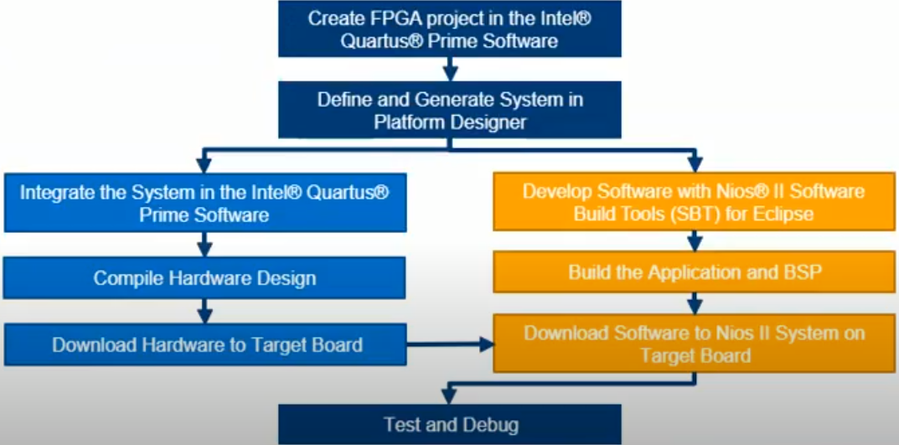
Nios II System Development Design Flow

Slide 18
03
Altera DE2-115
Development and Education Board

Slide 19
Altera DE2-115
The latest Altera DE2-115 features the Cyclone IV E device. Responding to increased versatile low-cost spectrum needs driven by the demand for mobile video, voice, data access, and the hunger for high-quality images, it offers an optimal balance of low cost, low power and a rich supply of logic, memory and DSP capabilities.
The Cyclone EP4CE115 device equipped on the DE2-115 features 114,480 logic elements (LEs), the largest offered in the Cyclone IV E series, up to 3.9-Mbits of RAM, and 266 multipliers. In addition, it delivers an unprecedented combination of low cost and functionality, and lower power compared to previous generation Cyclone devices.

Slide 20
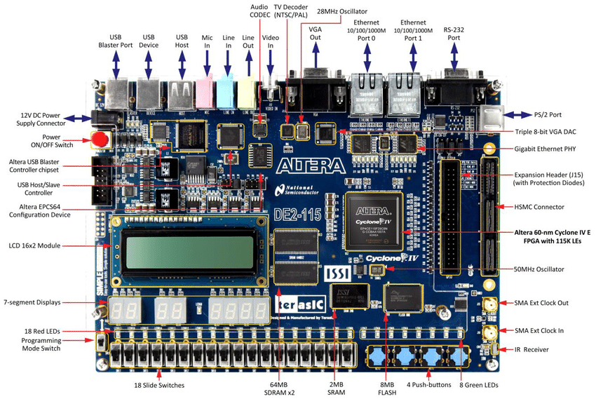
Altera DE2-115 Board Architecture

Slide 21
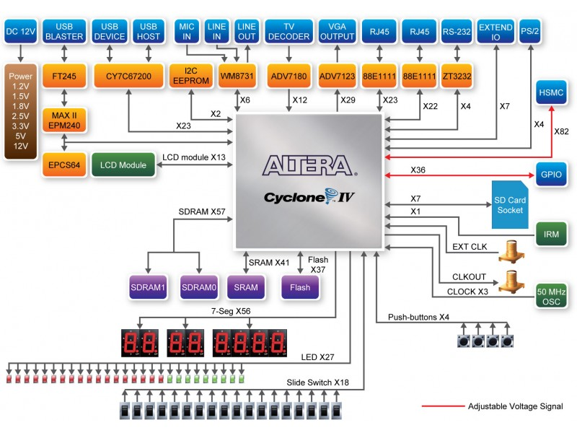
Altera DE2-115 Block Diagram

Slide 22
04
Cpulator
Altera DE2-115 Web-based Simulation

Slide 23
What is a CPU Simulator?
Simulation allows running and debugging programs without needing to use a hardware board. When loading a program onto the simulator, the program will behave (almost) identically to the same program running on real hardware.
A simulator has several advantages over hardware. It is more convenient and easily accessible than a hardware board. Also, compared to hardware, a simulator has greater visibility into the system state and can warn about suspicious behaviors, such as self-modifying code or making debugging easier.
There are many CPU simulators in the industry, including MARS 4.5, QtSPIM 9.1.20, ARMSim 1.91, but each of them have specific instruction set support, and all them require a Desktop installation, except for CPUlator which is web-based.
Popular CPU Simulators

Slide 24
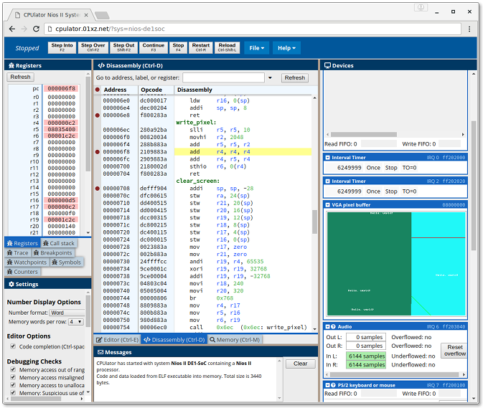
Example of a Simulator: CPUlator
CPUlator is a simulator and debugger of a computer system (CPU, memory, and I/O devices) that runs inside a web browser.
The simulated systems are based on Nios II, ARMv7 or SPIM (MIPS).
CPUlator's design was based on the computer systems from the Altera Monitor Program (Nios II and ARMv7) or SPIM (MIPS).

Slide 25
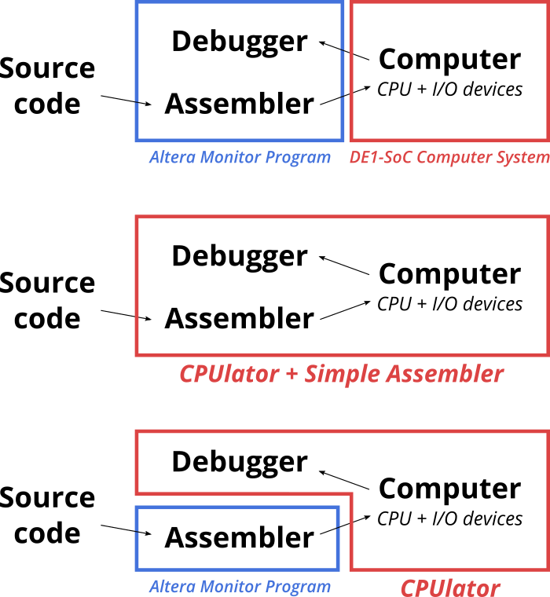
CPUlator’s Design
There are four main components in a typical development flow for simple assembly programs:
Source code written by the user.
An assembler (or compiler for a higher-level language) to transform the source code into executable machine code
A computer system to run the machine code
A debugger to observe the behavior of the program running on the computer.
Internally, the CPUlator simulator simulates executable machine code (it does not directly simulate assembly source code).
The built-in editor and assembler is limited to working with a single assembly-language source file. If your program requires more than one file or is written in another language (e.g, C), you must compile the program yourself and simulate the compiled executable.

Slide 26
Compilation with the Built-in Assembler
The built-in assembler is an interface to the GNU assembler. When Compile and Load is clicked, the contents of the Editor is uploaded to the server, saved as a single file, then run through the GNU assembler. The server then sends back the ELF executable and any assembler output messages, and the executable is loaded into the simulator.
Because the ELF file is generated at the server, there are limits on the size of the compiled executable (currently 12 MB). If your program is bigger than a megabyte (which sometimes happens if it includes images or audio as initialized data), it is usually faster to compile your program locally than to download megabytes at every compile.
If your program is substantially bigger than this, be aware that the executable size causes the simulator itself to consume memory to hold the executable. Don't expect the simulator to ever work with gigabyte-sized executables.

Slide 27
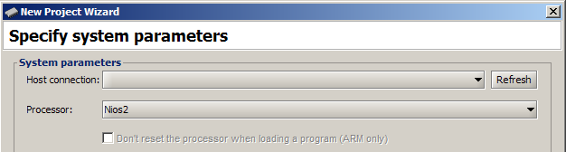
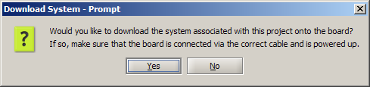
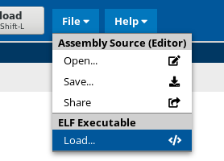
Compilation using Altera Monitor Program
The Altera Monitor Program can be used to compile projects without being connected to an FPGA board, as long as actions that interact with the board are avoided.
When creating a project, specify the "DE2-115 Computer" system. This is important because the compiler makes certain assumptions (e.g., system memory size) that depend on the computer system, and should match what's being simulated.
When prompted, do not download the computer
system to the board.
You can now "Compile" your project, but do not use "Load“
nor "Compile & Load". Compiling the program produces a
filename.elf executable file in your project directory.
To load the executable into the
CPUlator simulator, use File → Load ELF Executable and
choose this executable file.

Slide 28
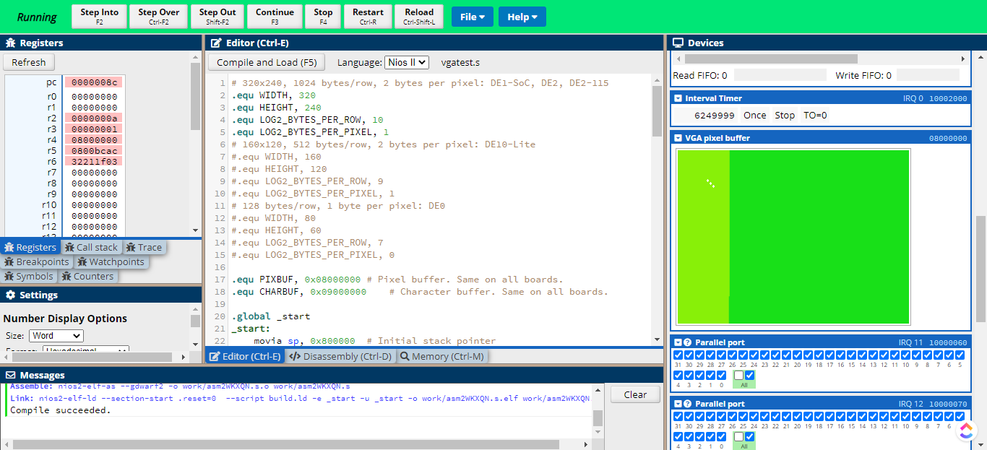
Simulation 1: Included Sample VGA test
The purpose of this program is to test a VGA display by cycling through a color spectrum.

Slide 29
Simulation 1: Included Sample VGA test
Memory Registers
VGA output
Editor

Slide 30
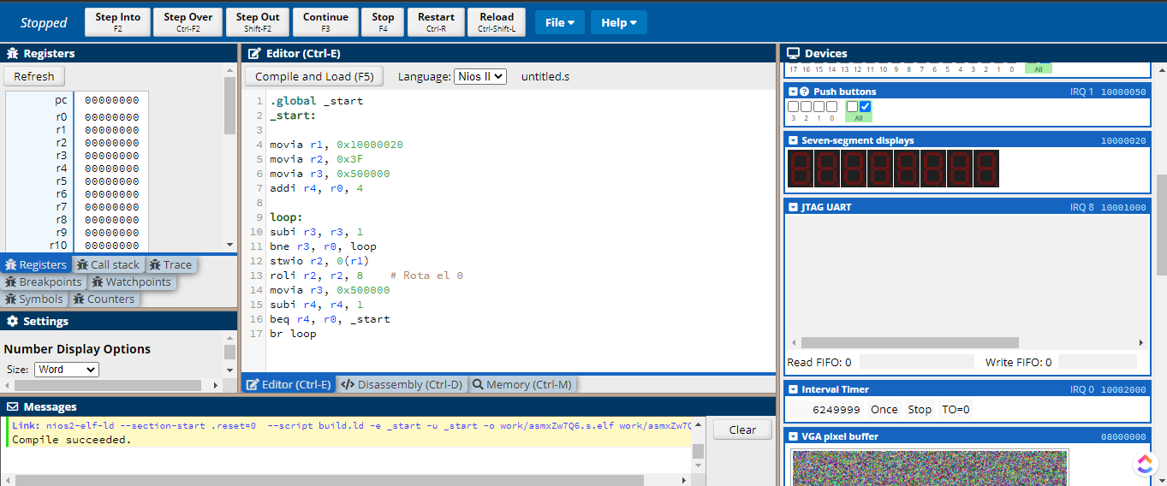
Simulation 2: Zero Rotation
The goal is to design an assembly program that shows on the DE2 board a zero on the first "seven-segment" display and rotate it through the first four displays "seven-segments". Note: Observe the address assignments of the parallel interfaces of seven-segment displays.

Slide 31
Simulation 2: Zero Rotation
Memory Registers
Disassembly
Output

Slide 32
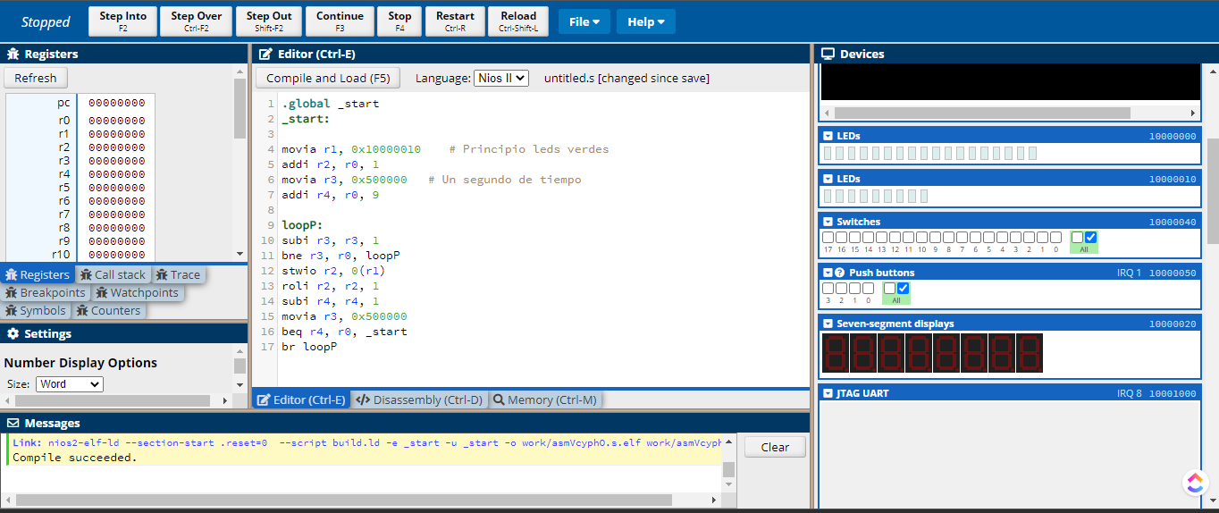
Simulation 3: Green LED Train
Design an assembly program that alternately turns on each of the the green leds of the DE2 board. Note: Observe address assignment of the parallel interface NIOS II processor address space of green leds.

Slide 33
Simulation 3: Green LED Train
Memory Registers
Disassembly
LED output

Slide 34
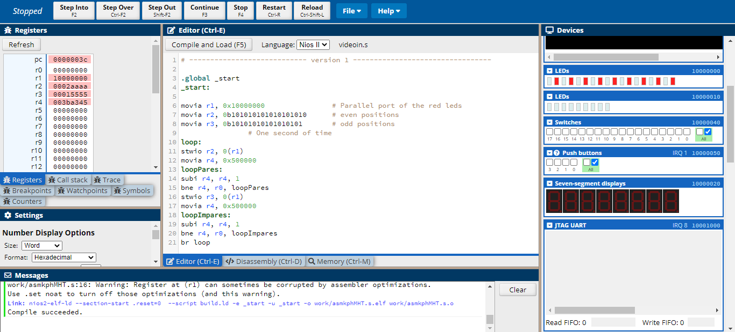
Simulation 4 : Alternating Red LEDs
We designed an assembly program that alternately turns on all the red LEDs in even positions and all red LEDs in odd positions.

Slide 35
Simulation 4 : Alternating Red LEDs
Memory Registers
Disassembly
LED output

Slide 36
References
https://en.wikipedia.org/wiki/Nios_II
https://web.archive.org/web/20101225092752/http://www.altera.com/products/ip/processors/nios2/ni2-index.html
https://www.intel.com/content/www/us/en/products/details/fpga/nios-processor/ii.html
https://www.youtube.com/watch?v=lG2I56NKLQk&ab_channel=IntelFPGA
https://cpulator.01xz.net/doc/#implementation

